Slide 1


Slide 2

WELCOME
We are Mahedi Hasan and Nafisa Shamim presenting you guys hospital management system.

Slide 3
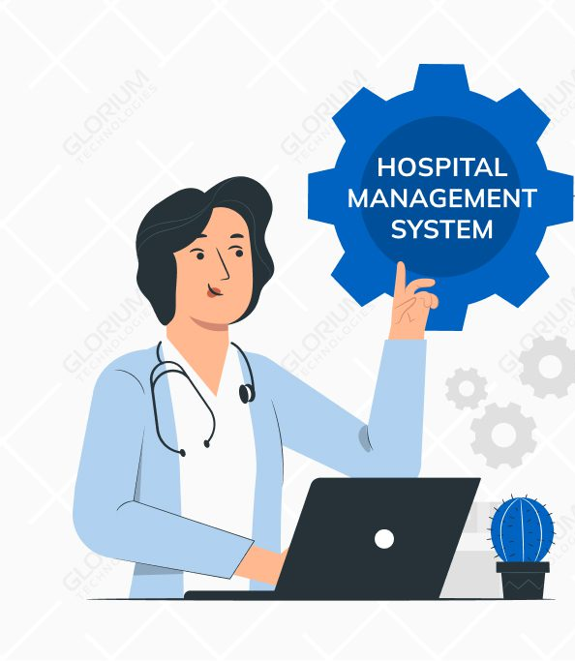
MAIN FEATURES
DEPARTMENT SELECTION
PATIENT REGISTRATION
PATIENT DETAILS DISPAY
IDENTIFICATION OF CRITICAL PATIENT
AVAIABLE DOCTOR
DELIVERYING PATIENTS DETAILS TO DOCTOR

Slide 4
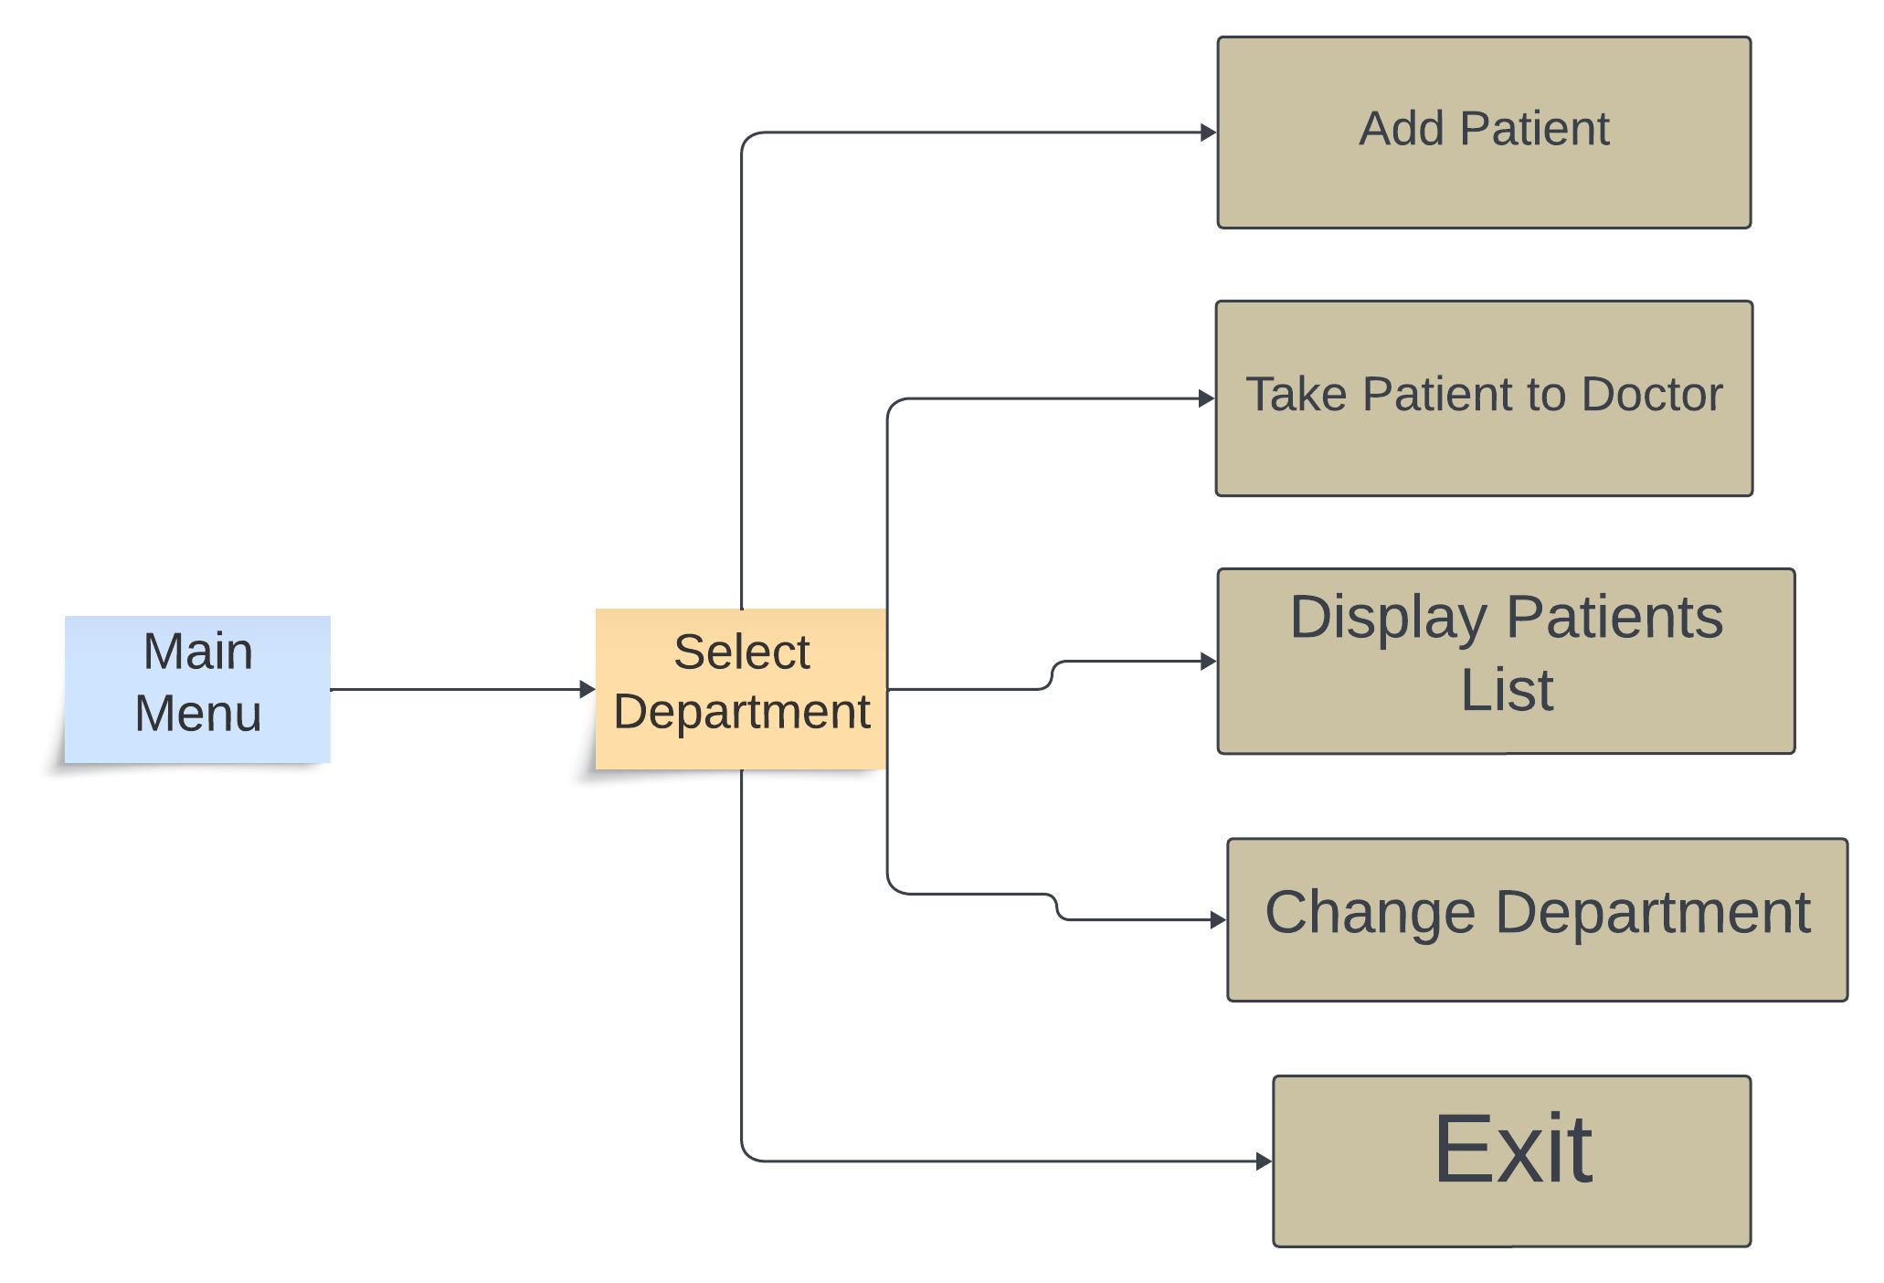
Data Flow Diagram

Slide 5
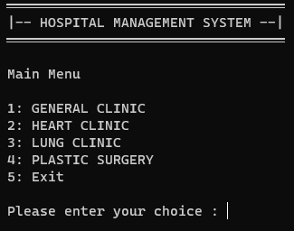
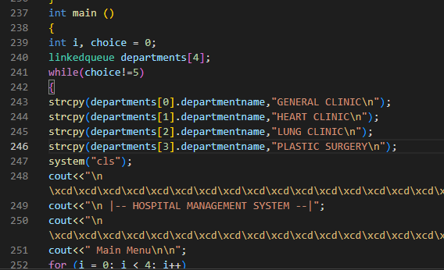
Main Menu
CODE
OUTPUT

Slide 6
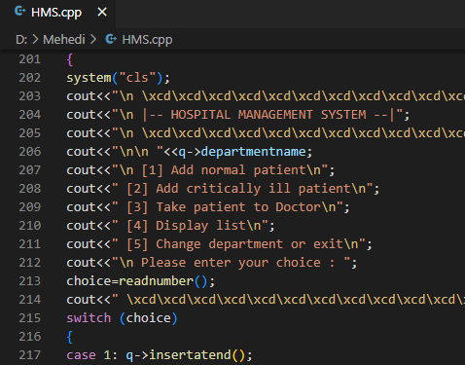
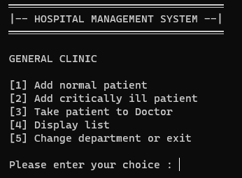


Facilities of each Unit

Slide 7
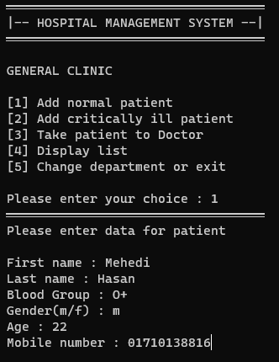
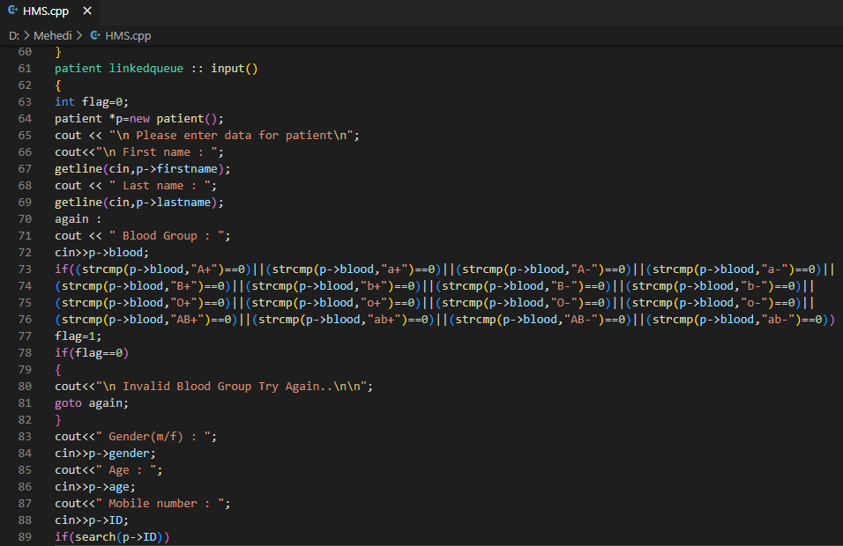


Patient Registration

Slide 8
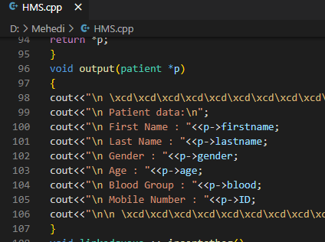
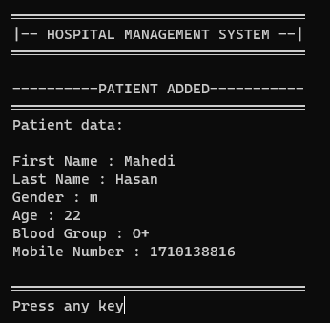


Patient Record

Slide 9
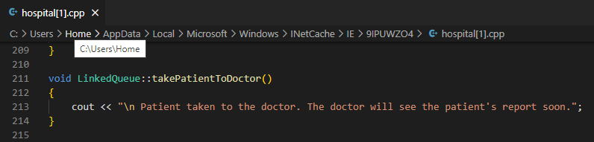
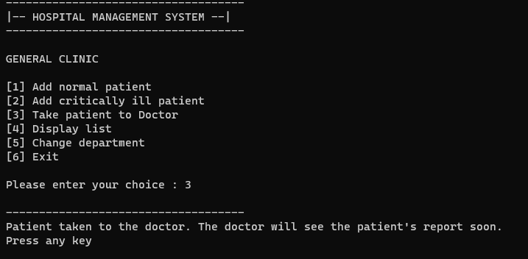
Transfering Patient info to doctor

Slide 10

CONCLUTION
The C++ code presents a basic hospital management system with linked lists for patient records across departments. Users can add patients, view lists, and simulate patient-doctor interactions. The code is functional but would benefit from improved input validation and enhanced user features. It serves as a starting point for a simple system but needs refinements for real-world use.

Slide 11
Thank You

